Slide 1
Shop prime

Slide 2
MODULES/TECHNOLOGIES USED:
HTML
HTML stands for Hyper Text Markup Language.
HTML is the standard markup language for creating Web pages.
HTML describes the structure of a Web page.
HTML Headings:
HTML headings are defined with the <h1> to <h6> tags.
<h1> defines the most important heading.
<h6> defines the least important heading.
EXAMPLE:
<h1>heading</h1>

Slide 3
CSS
CSS stands for Cascading Style Sheets.
CSS describes how HTML elements are to be displayed on screen, paper, or in other media.
CSS saves a lot of work. It can control the layout of multiple web pages all at once.
Three Ways to Insert CSS:
1.External CSS
2.Internal CSS
3.Inline CSS

Slide 4
JAVASCRIPT
JavaScript is the world's most popular programming language.
JavaScript is the programming language of the Web.
JavaScript is easy to learn.
JAVASCRIPT FUNCTIONS:
A JavaScript function is a block of code designed to perform a particular task.
A JavaScript function is executed when "something" invokes it (calls it).

Slide 5
Abstract
Shop Prime is an e-commerce website.Online shopping has become a very large industry these days as it provides wide range of products to buy and saves time of going to shop and searching for required products.Some may be available or some may be not but on shopping websites they will be available.My website opens its home page at first.From there you can navigate through different categoriesv of products.There is a Signup button in navigation bar which redirects user to account creation for the website.When user clicks on Buynow button user will be redirected to payment page where user will be provided with various payment options.User can select any payment option according his/her convenience.

Slide 6
Code of each product card
<div class="column">
<div class="card">
<img src="xbox.jpg" style="width: 75%;height: 75%;">
<h3>xbox gamepad</h3>
<p class="price">Rs.5000</p>
<form action="checkout.html">
<p><button>Buy Now</button></p></form>
</div>
</div>

Slide 7
Password validation
<script>
function validateForm() {
let user = document.forms["form"]["Email"].value;
let np = document.forms["form"]["NP"].value;
if (user == "")
alert("Email must be filled out"); return false;
}
if (np == "") {
alert("PASSWORD must be filled out");
return false;
}
else if(np.length<5 || np.length >20){
alert("PASSWORD length must be between 5 and 20");
return false;
}
}
</script>

Slide 8
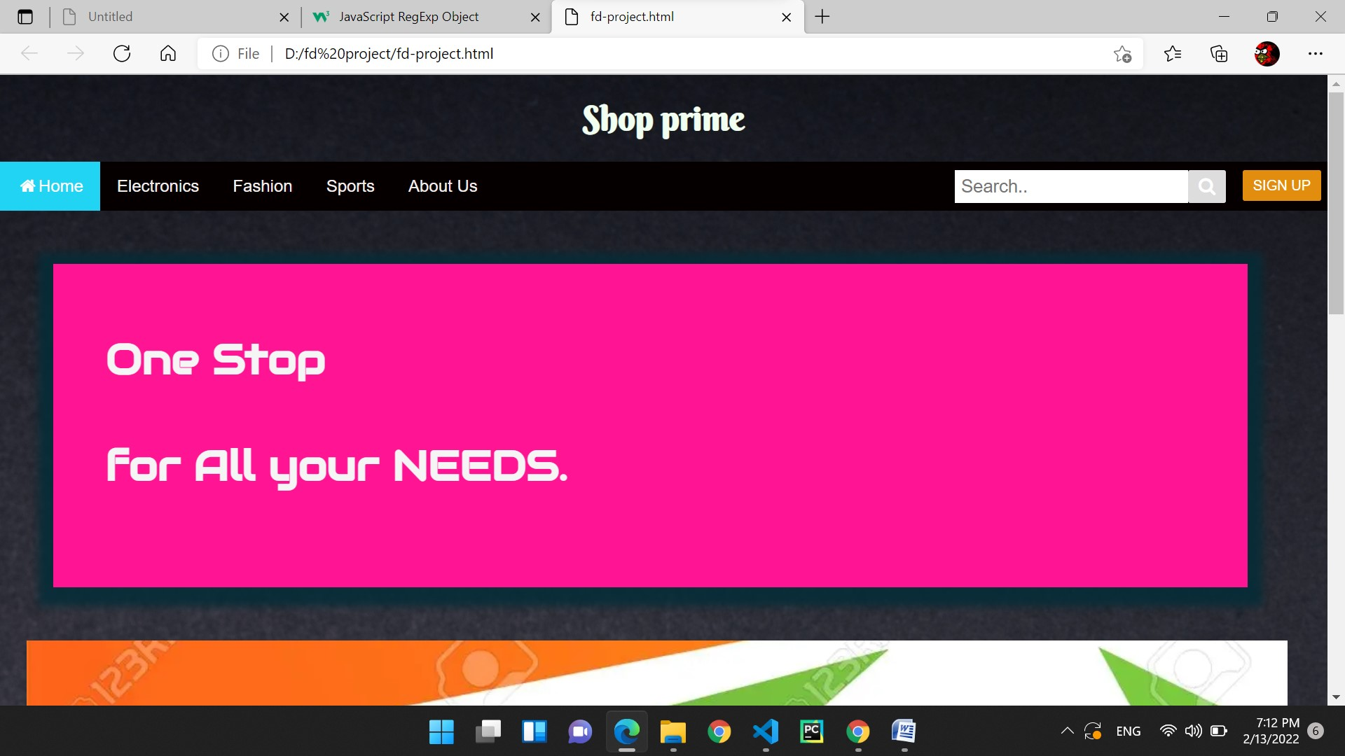
Outputs

Slide 9
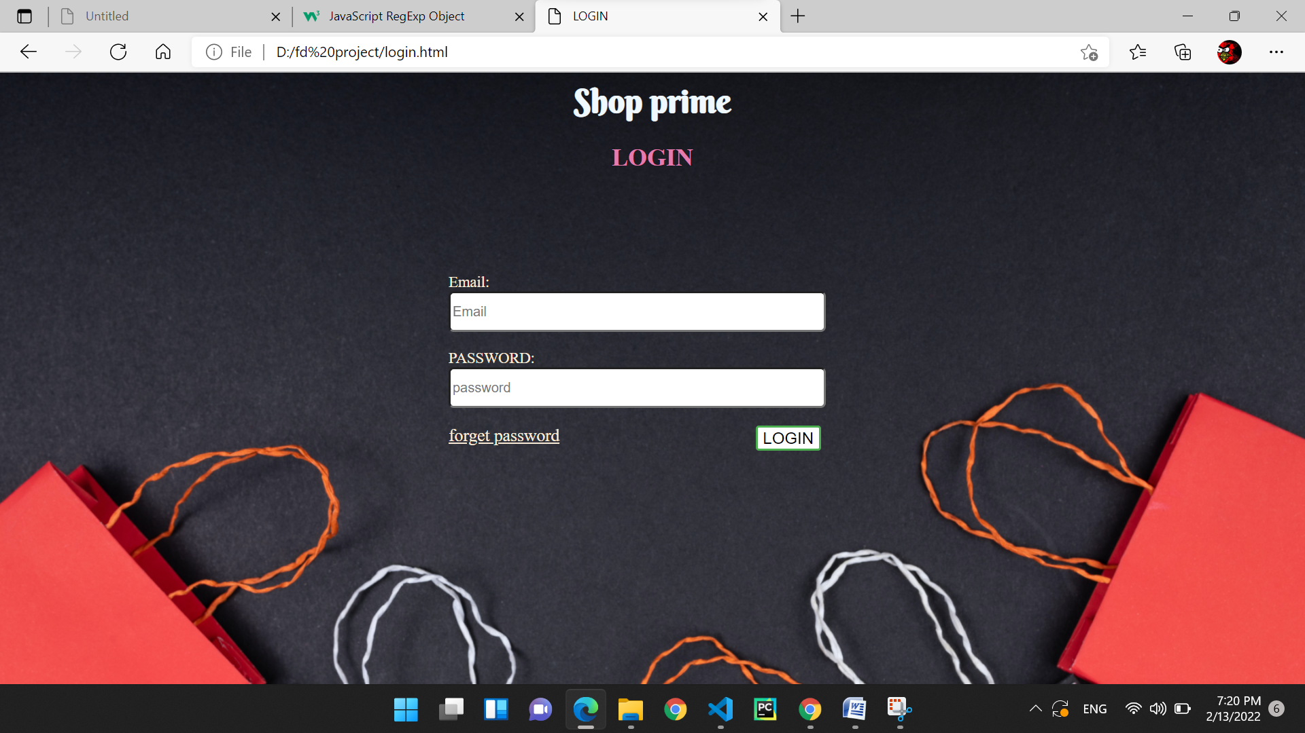

Slide 10
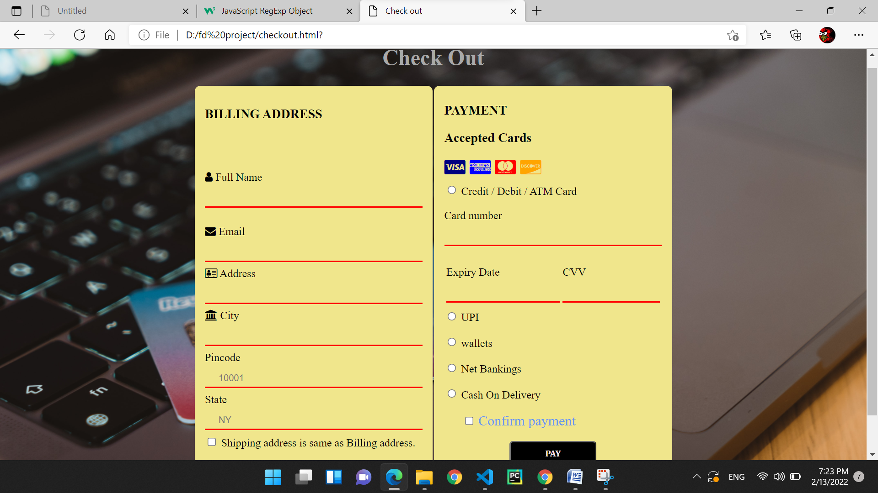

Slide 11
Conclusion:
At the end of this project I learnt basic webdevelopment techniques i.e,Html,Css,Javascript..
I was able to create my own website.
By seeing any website I was able to understand the source code of other websites.
References:
HTML Tutorial (w3schools.com)
CSS Tutorial (w3schools.com)
JavaScript Tutorial (w3schools.com)

